Slide 1


Alfred Nobel
The Inventor of the Nobel Peace Prize!

Slide 2

Alfred’s Childhood
Alfred Nobel was the son of Caroline Ahlsell and Immanuel Nobel. He was a brother of 8, but only Alfred an three of his brothers survived past their childhood. When he was 4, his father moved to St Petersburg, Russia (his family moved there in 1842). When he was in Russia he was able to go to the only school he ever went to as a child, the Jacobs Apologistic School in Stockholm for 18 months.

Slide 3
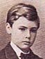
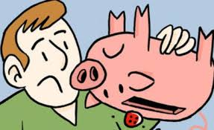
When was Nobel born?
Alfred Nobel was born in Stockholm, Sweden on 21st October 1833. His mother, Caroline came from a wealthy family, though his father Immanuel went into bankruptcy the year Alfred was born.

Slide 4
Alfred’s First Job
When he was 17 Nobel studied in Paris to continue the research he did with the chemist Nikolai Zinin. A year later he went to the States for 4 years to study chemistry, for a short period under the direction of Inventor John Ericsson. Alfred also worked in his father’s factory, producing military equipment during the Crimean War.

Slide 5

What are some of the Achievements that made Alfred Nobel great?
Alfred Nobel achieved many great things in his life. He had 355 Patents, an outstanding amount.
Nobel also created one of the most dangerous explosives in the world, Dynamite!
However, his greatest achievement was of course the Nobel Peace Prize, which lives on to this very day!

Slide 6
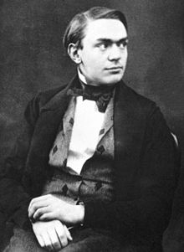
What was his family life like?
Although Alfred was very rich he had no wife. When he was 43, Nobel almost married the Austrian Pacifist Bertha von Suttner. As he had no children, Alfred gave $250 million to fund the Nobel Peace Prize.

Slide 7

My Favourite Quote by Nobel
The Quote by Alfred Nobel I like the most is “If I have a thousand ideas and only one turns out to be good, I am satisfied” because it really makes you think. Also I like it as it means even if you have hundreds of ideas not all of them will be amazing.

Slide 8

When and where did Nobel die?
Sadly, on the 10th December 1896 Alfred died aged just 63. He died in his holiday villa in San Remo, Italy of Cerebral Haemorrhage, otherwise known as a Stroke. In 1895 he had his will drawn up, which said to give basically his whole fortune to endow the Nobel Peace Prize.

Slide 9

If Alfred Nobel was alive today I would ask him:
Why did you use Nitro-glycerine to make Dynamite if it killed your brother Emil??????

Slide 10
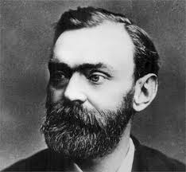
The Personality traits of Nobel I most admire are:
His Generosity, the way he not only realised he needed to do something else with his life but he actually did do something else and the way he was fascinated by all of the sciences because it is good to have these qualities.

